Slide 1

Supervised machine learning
Associated notebook: https://github.com/stfc-sciml/sciml-workshop/blob/master/course_1.0/01_classification_decision_tree.ipynb

Slide 2
Overview
Types of ML
Parameters and hyperparameters
Features
Decision trees
Evaluation/metrics
Overfitting
Bagging and boosting

Slide 3
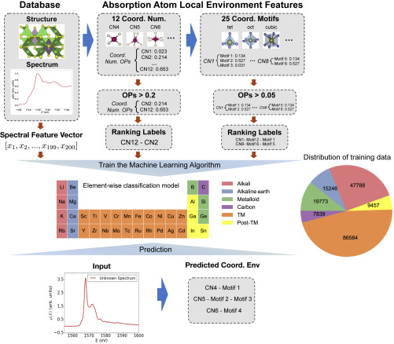
Showcase
Directly predicts the atomic environment labels from the X-ray absorption near-edge structure
Accuracy exceeding 80%
Accelerated or even on-the-fly interpretation of spectra directly from experiments
Patterns, 2020, 1, 100013

Slide 4
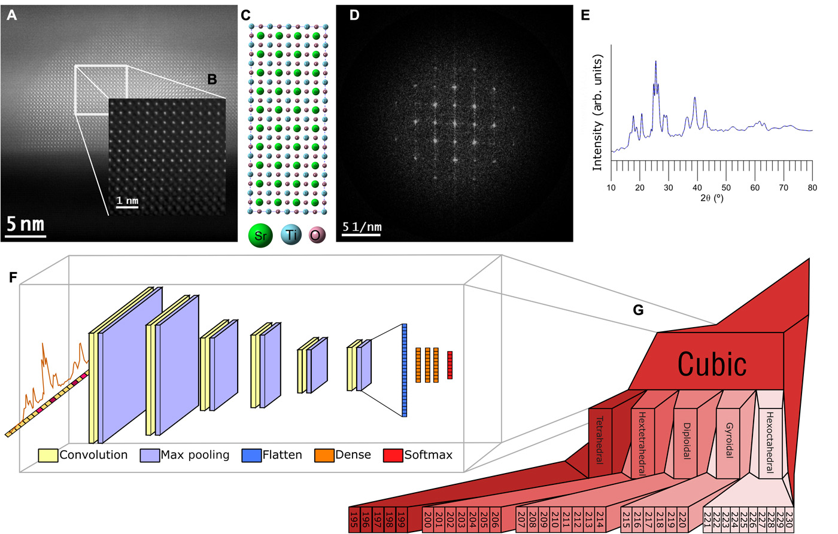
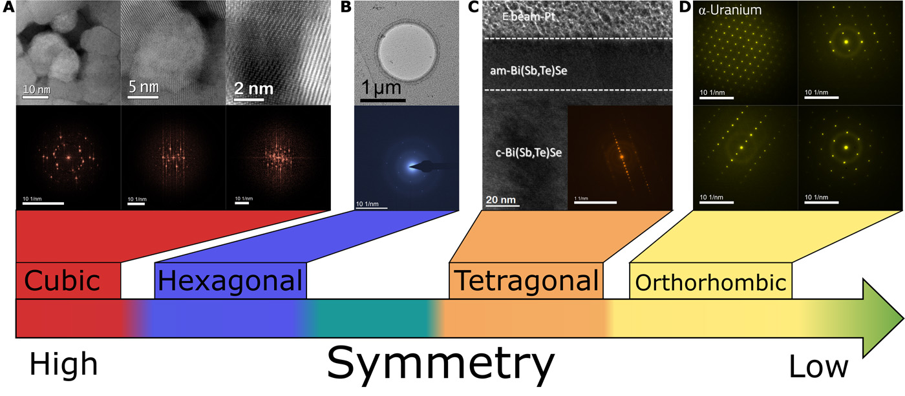
Showcase
Interpreting electron diffraction crystallography using supervised ML
Models trained on simulated diffraction patterns
Can narrow down possible spacegroups to the top two with 95% confidence
Even peaks in low signal-to-noise images can be potentially used
Science Advances 2019, 5, eaaw1949

Slide 5
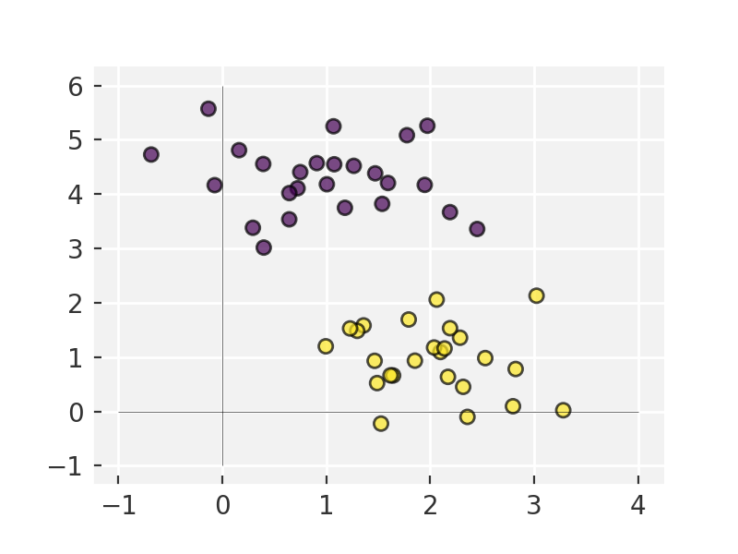
Supervised ML
Data plus labels
Learning a function that maps an input to an output based on example input-output pairs.

Slide 6
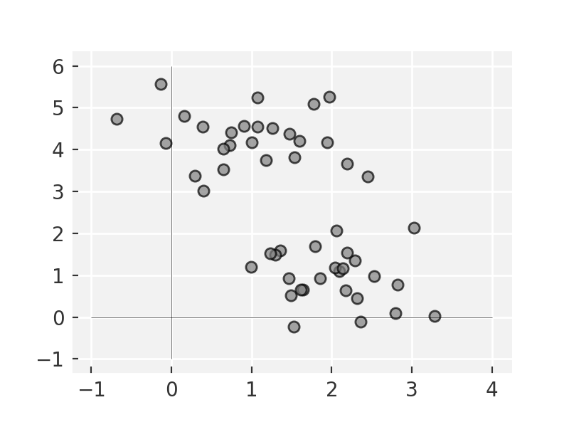
Unsupervised ML
Data do not have labels
Identifying trends in unlabelled datasets
E.g. cluster analysis, is used for exploratory data analysis to find hidden patterns or grouping in data

Slide 7
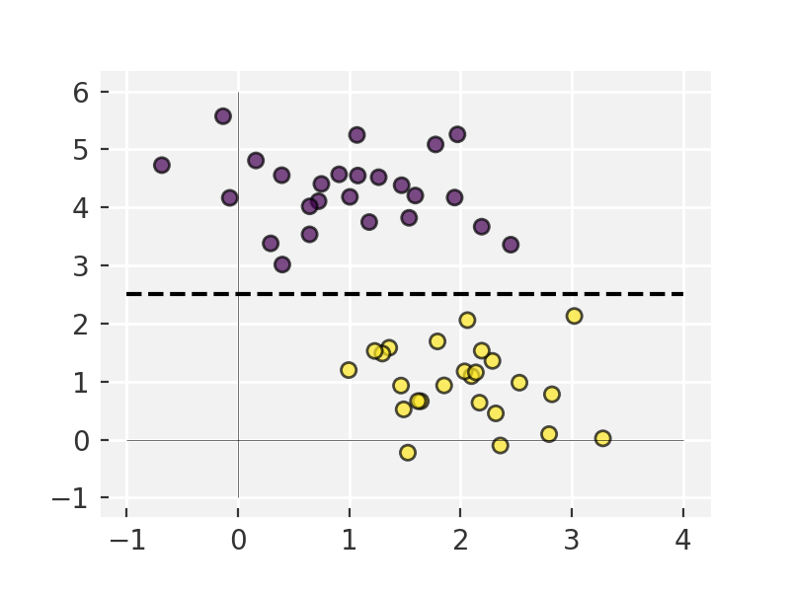
Classification
Identifying to which of a set of categories a new sample belongs, on the basis of a training set
E.g. spam filter or which crystal structure gives a certain pattern

Slide 8
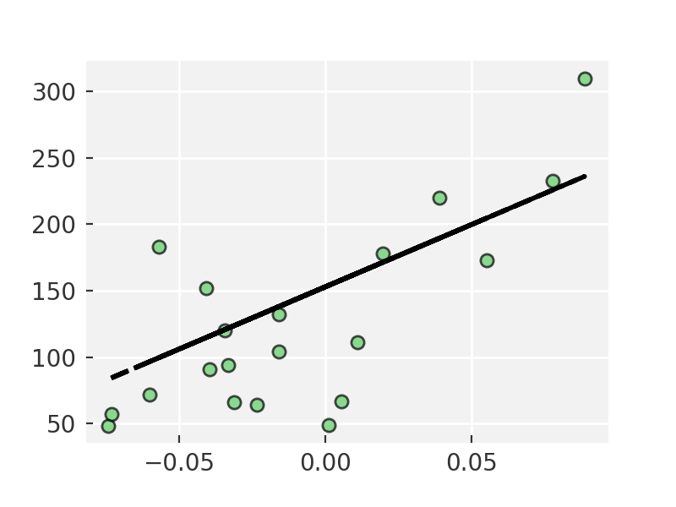
Regression
Models a target prediction value based on independent variables

Slide 9
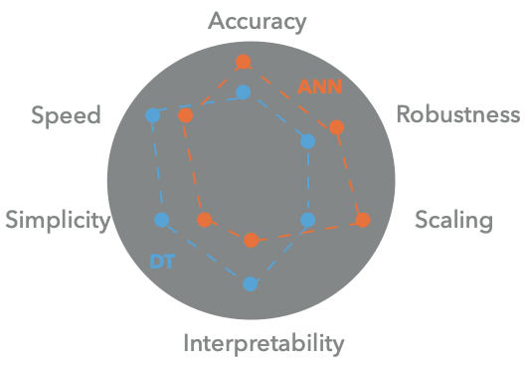
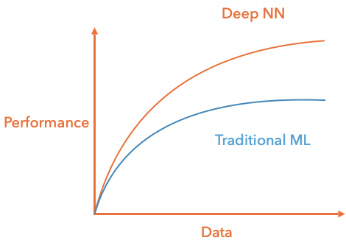
Classical/deep methods
Classical: linear regression, trees etc..
Deep: neural network type models

Slide 10
Parameters and hyper-parameters
Parameters – properties of the model that are modified during training
Hyperparameters – set of values that define the model and how it trains. Do not update during training
E.g. loss function, learning rate, number of parameters

Slide 11
Features
In ML approaches the data will typically consist of several or more features
Features are simply the input variables for the model – x in f(x) = y
“…some machine learning projects succeed and some fail. What makes the difference? Easily the most important factor is the features used.”
"A Few Useful Things to Know About Machine Learning" by Pedro Domingos

Slide 12
Feature engineering
Transforming raw data into features that better represent the underlying problem
Make inputs into things that an algorithm can understand
E.g. Convert a date-time stamp into something more useful 2014-09-20T20:45:40Z -> Day: Tuesday; Year: 2014; Month: Sept
Note that ‘Tuesday’ and ‘Sept’ are not particularly algorithm ready – how can we convert them to something more useful?

Slide 13
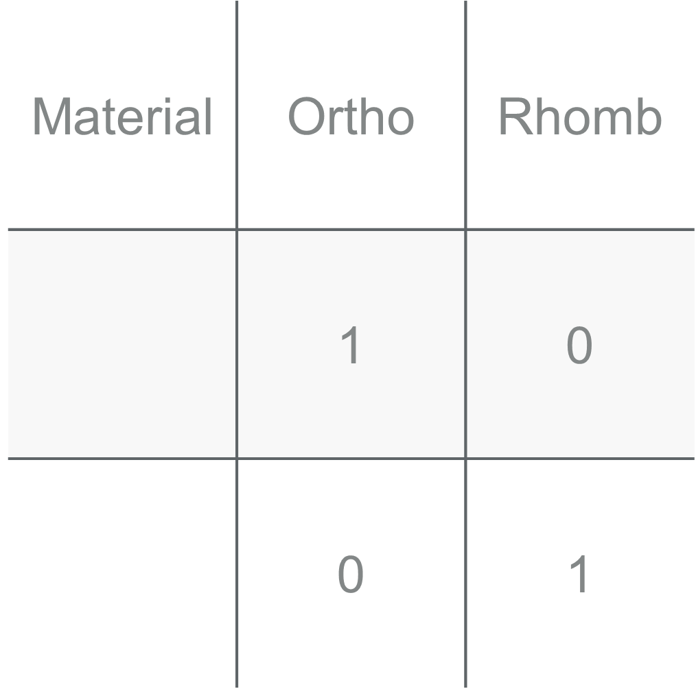
One hot encoding
Classification problems
Vector of length = number of categories
Each element is the probability that the data represents a given class

Slide 14
Building block: One hot encoder
from sklearn.preprocessing import LabelEncoder
from sklearn.preprocessing import OneHotEncoder
label_encoder = LabelEncoder()
integer_encoded = label_encoder.fit_transform(values)
print(integer_encoded)
onehot_encoder = OneHotEncoder(sparse=False)
integer_encoded = integer_encoded.reshape(len(integer_encoded), 1)
onehot_encoded = onehot_encoder.fit_transform(integer_encoded)

Slide 15
Decision trees
Data is split by features. E.g. brightness of a pixel
Splits are arranged such that the data splits as evenly as possible at each point.

Slide 16
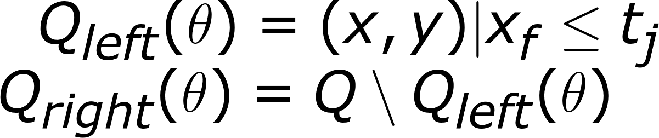
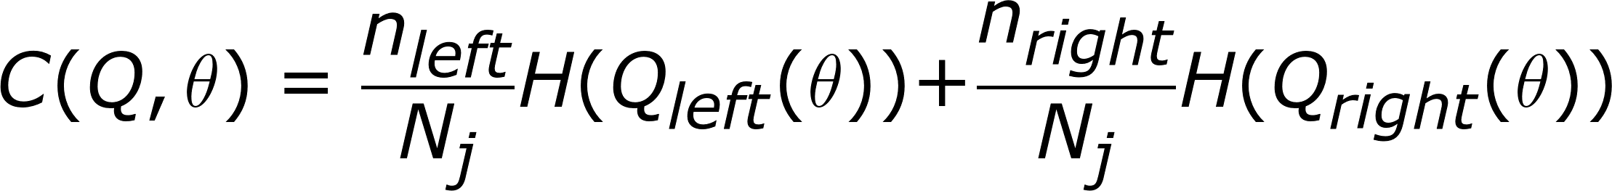
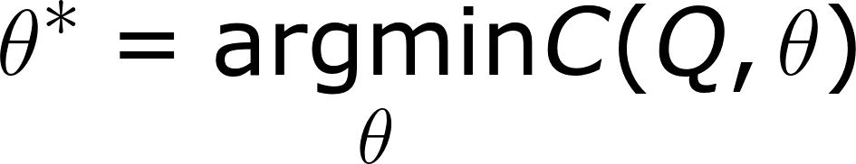
Decision trees
Data is split according to a threshold value tj.
The cost of the split is calculated based on some impurity function H() e.g. RMSD of the data.
The splitting parameters are chosen to minimise C at each split.

Slide 17
Go to notebook

Slide 18
Optimisation/Evaluation
Evaluation
Objective function or scoring function.
Distinguish good from bad models.
Objective function = loss function = cost function
Must faithfully represent the “goodness” of a model in a single number

Slide 19
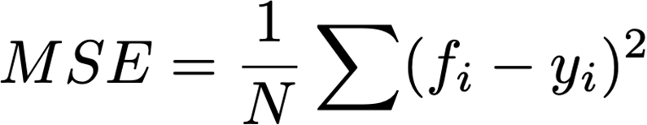
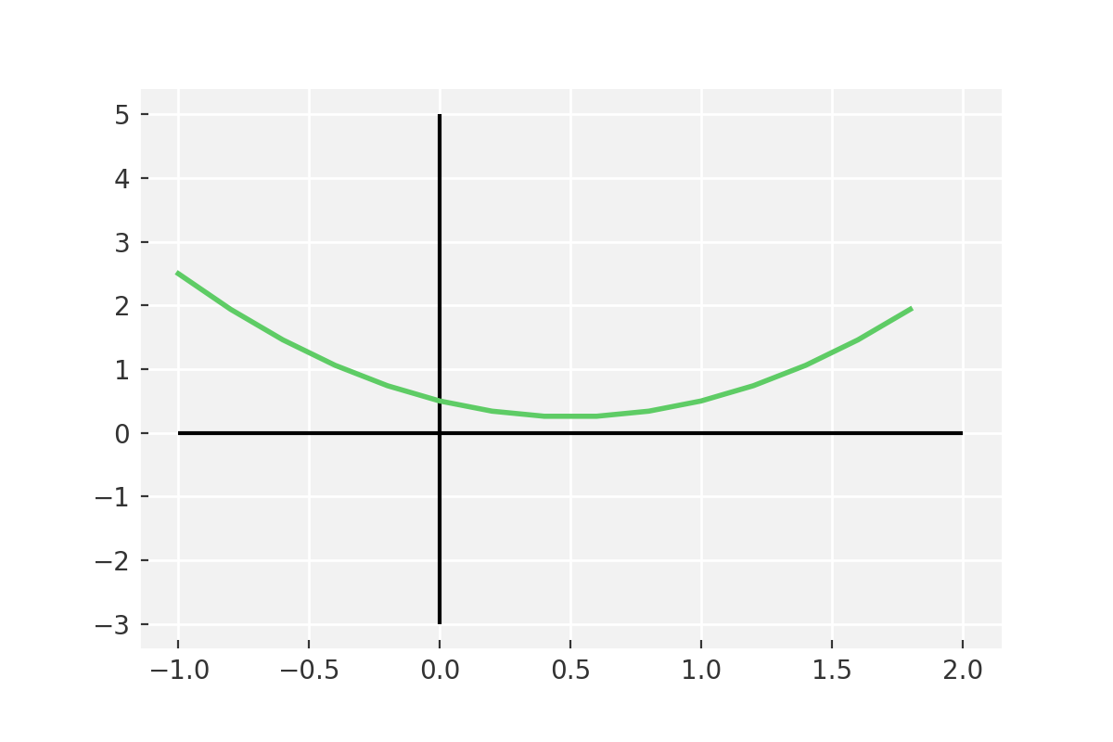
Evaluation metrics
Mean squared error
Used in regression
Square endures a single minimum
Avoids local minima trapping
Easy to calculate

Slide 20
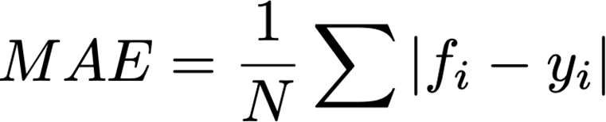
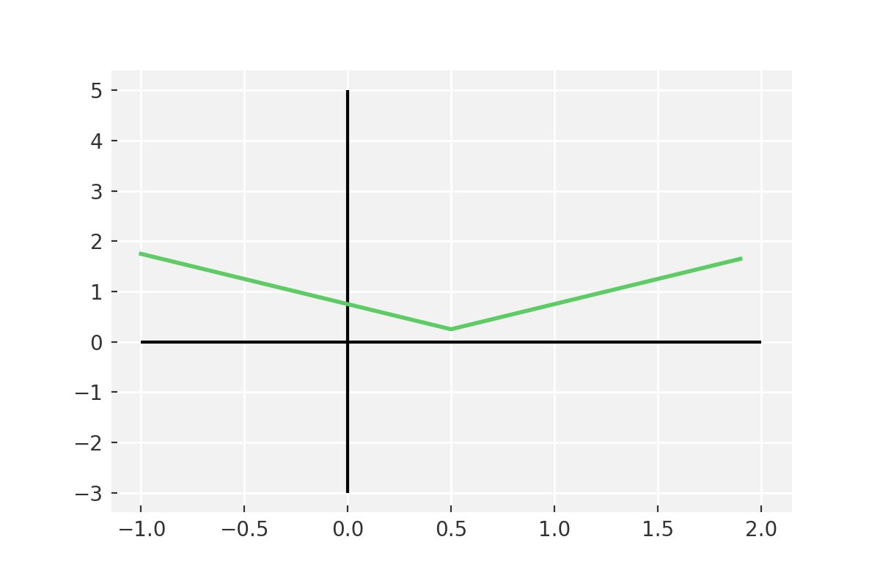
Evaluation
Mean Absolute Error
Similar to MSE
No quadric term
More robust to outliers
MSE penalises large differences much more than MAE
Large gradients close to zero - slow to optimise

Slide 21
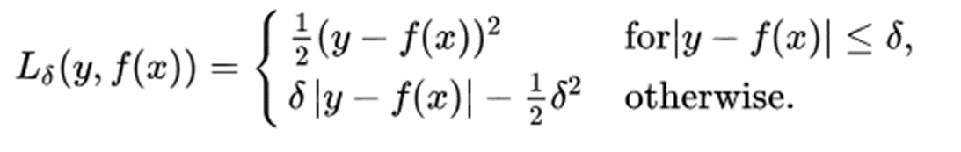
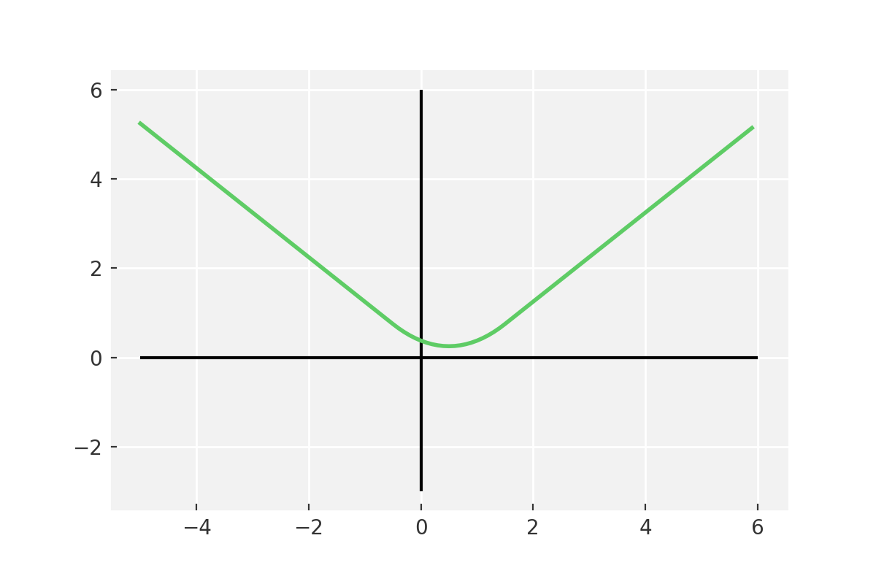
Evaluation
Huber loss
Quadratic close to the minimum
Linear far from the minimum
Overcomes problems of MSE and MAE
More expensive to calculate

Slide 22
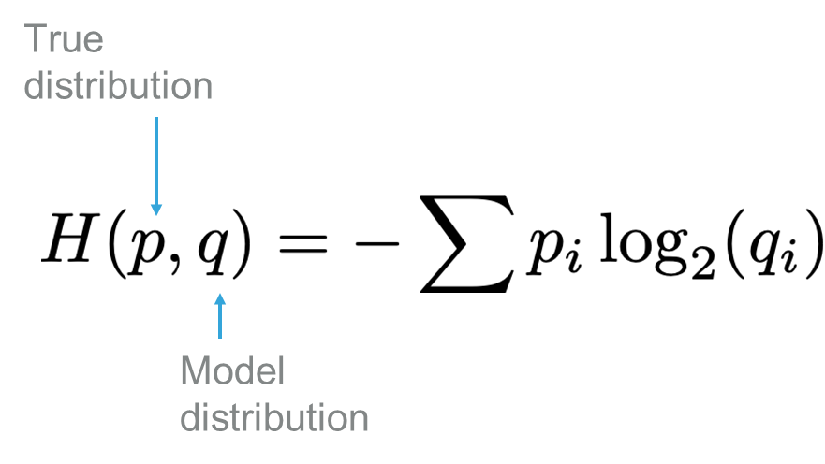
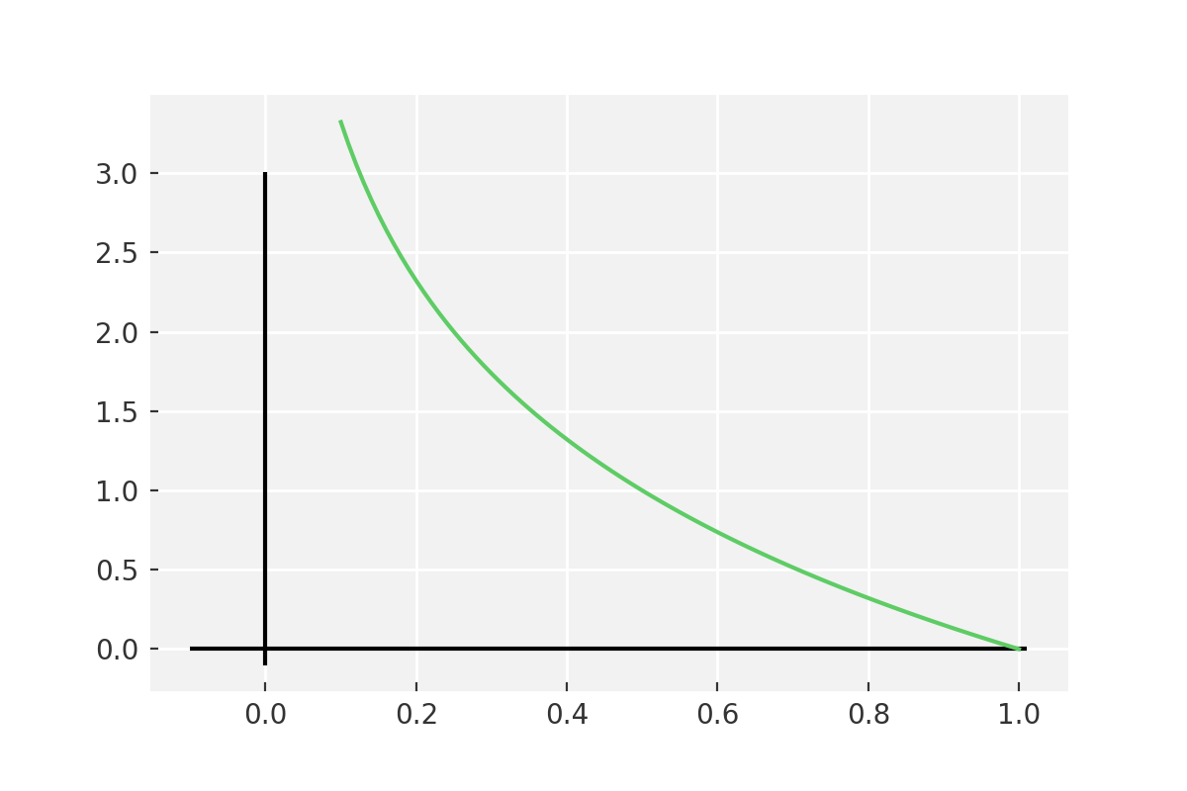
Evaluation
Cross entropy
Used for classification problems
Tells us how similar our model distribution is to the true distribution
Penalises all errors, but especially those that are most inaccurate
0 | 0 | 1 | 0
0.15 | 0.25 | 0.5 | 0.1

Slide 23
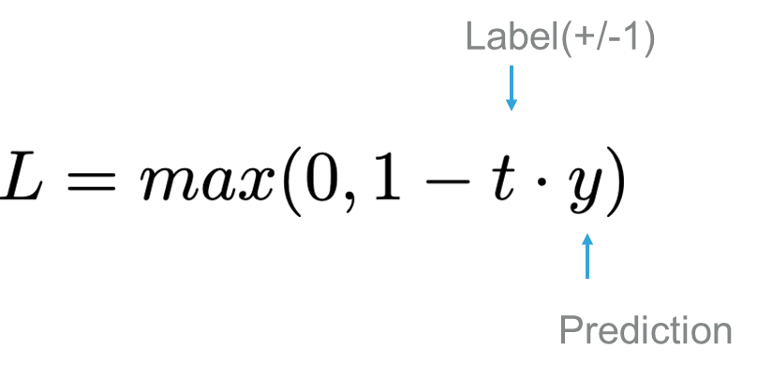
Evaluation
Hinge loss
Used for classification
Does not seek to reproduce the distribution of data
0 as long as the classification is correct

Slide 24
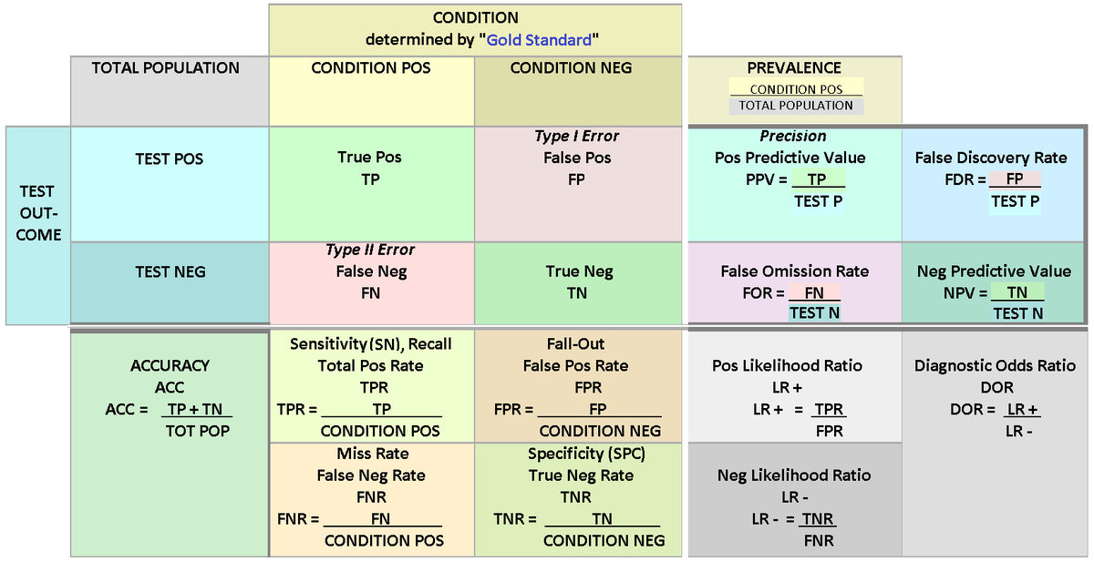
Evaluation: Table of confusion
https://en.wikipedia.org/wiki/Confusion_matrix

Slide 25
Evaluation
Over/under fitting

Slide 26
Test and validation sets
The model must always be validated on data not used for testing
Often something like 20% of data is used for validation
Make sure that validation and training distributions are the same

Slide 27
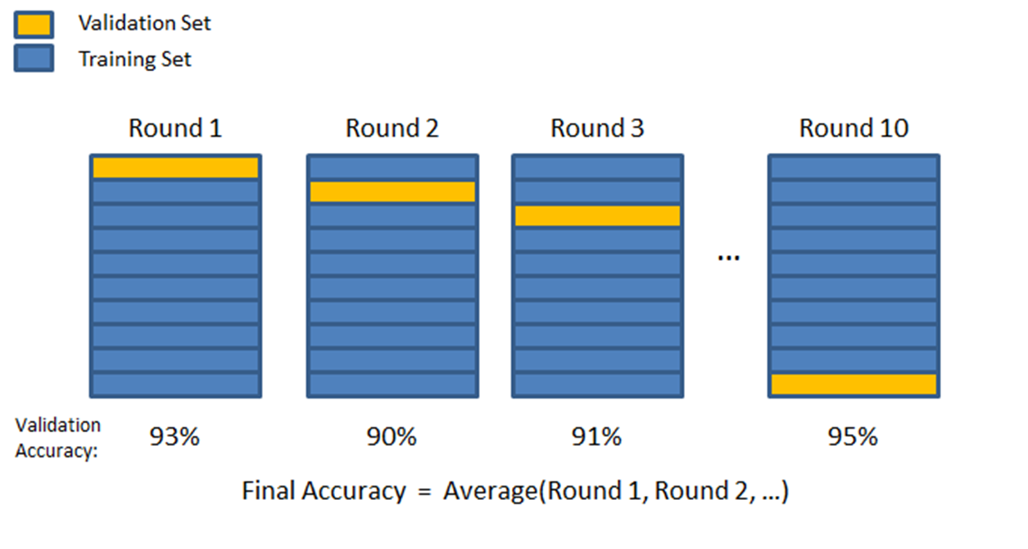
Evaluation
n-fold cross validation
Ensure training/test splits

Slide 28
Building block Cross Validation
from sklearn.model_selection import cross_val_score
clf = svm.SVC(kernel='linear', C=1)
scores = cross_val_score(clf, X, y, cv=5)

Slide 29
Go To Notebook

Slide 30

Boosting + Bagging
To overcome the limitations of a weak learner we can use booting or bagging.
Both methods use an ensemble of weak learners to build a strong learner
Boosting – choose next learner based on the errors of the last learner (gradient boosted decision trees)
Bagging – stochastically choose next learners (random forests)

Slide 31
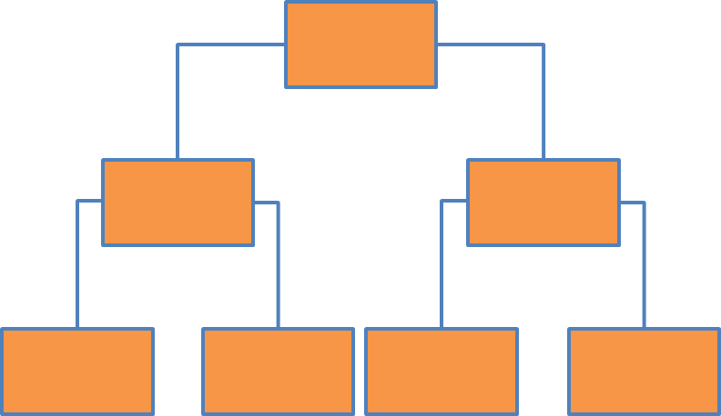
Boosted Decision Trees
New model
Learning rate
Previous model
Sub model of errors
Loss
Number of trees

Slide 32
Building block: Boosted decision tree
from sklearn import ensemble
gbr = ensemble.GradientBoostingRegressor(loss='lad', max_depth = 10, learning_rate = 0.015, min_samples_split = 50, min_samples_leaf = 1, max_features = len(cols), subsample = 0.9, n_estimators = 300)
gbr.fit(X, y)

Slide 33
Go To Notebook

Slide 34
Concept checklist
Supervised/unsupervised machine learning
Classical machine learning/deep learning
Parameters/hyperparameters
Features and feature engineering
Decision trees
Overfitting
Evaluation/metrics
Test/train split, cross-validation
Bagging and boosting

Slide 35
Thank you
Twitter:@ml_sci

